Slide 1
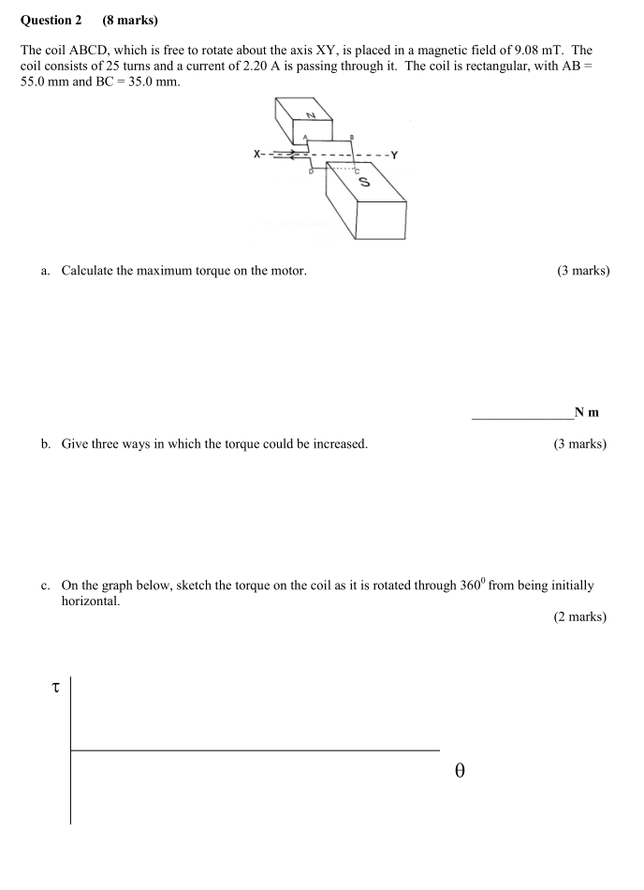

Slide 2
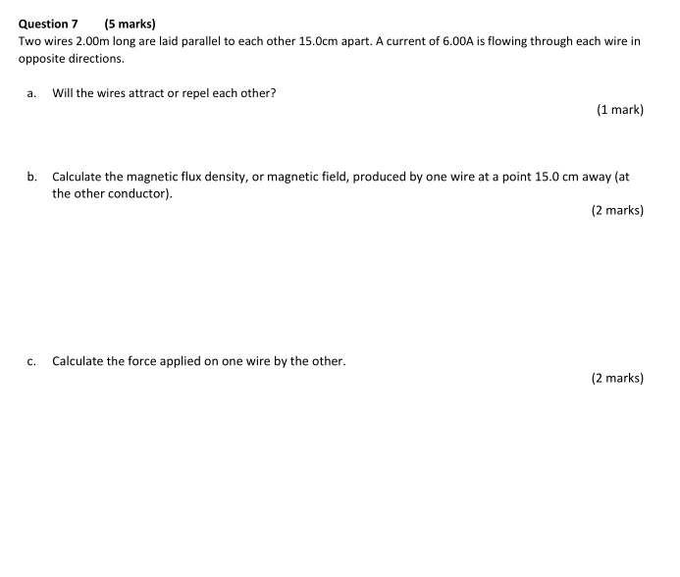
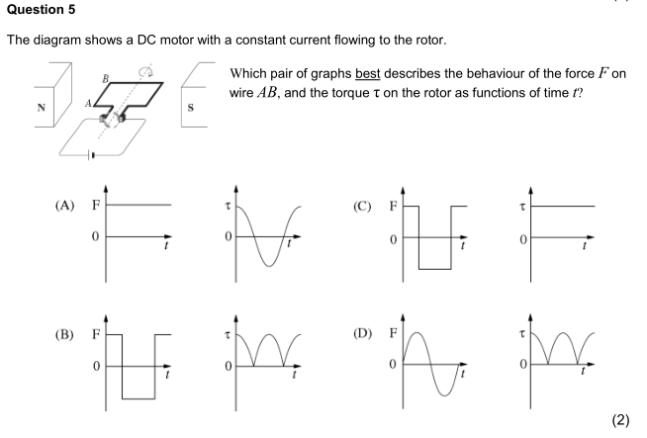

Slide 3
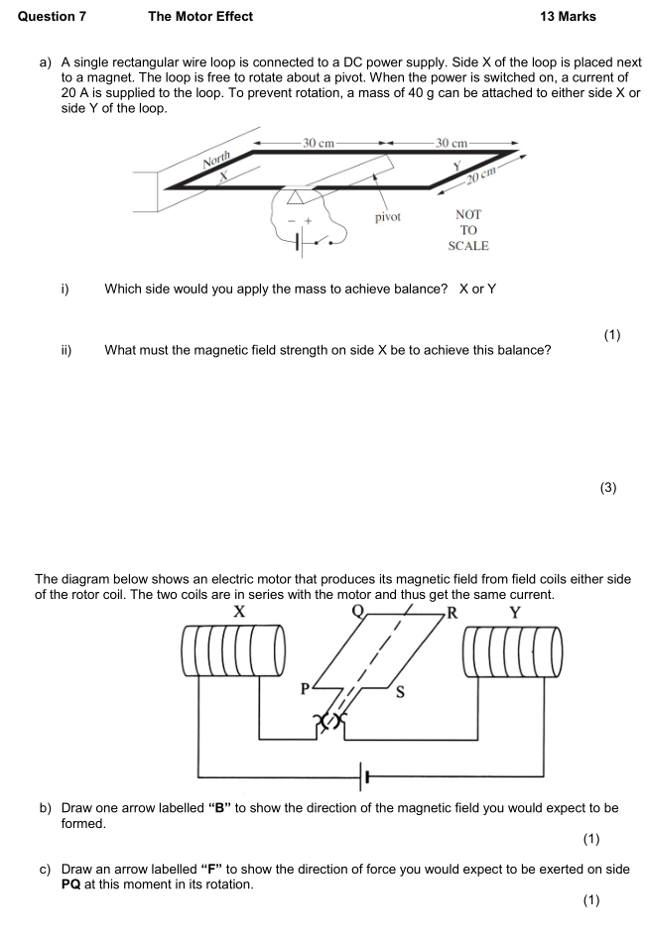

Slide 4
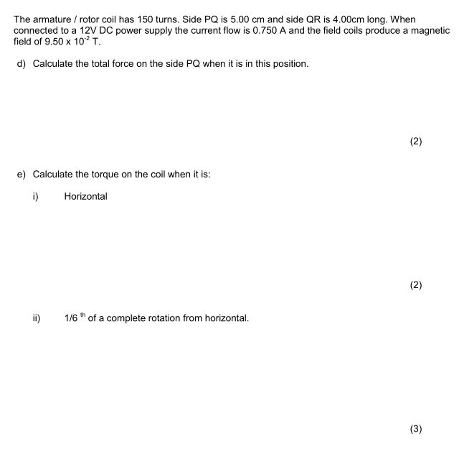
Explain three ways that you could increase the torque of a motor?
Explain the function (what it does) and purpose (why it is needed) of the following parts of a DC motor:
The armature coils
The carbon brushes

Slide 5
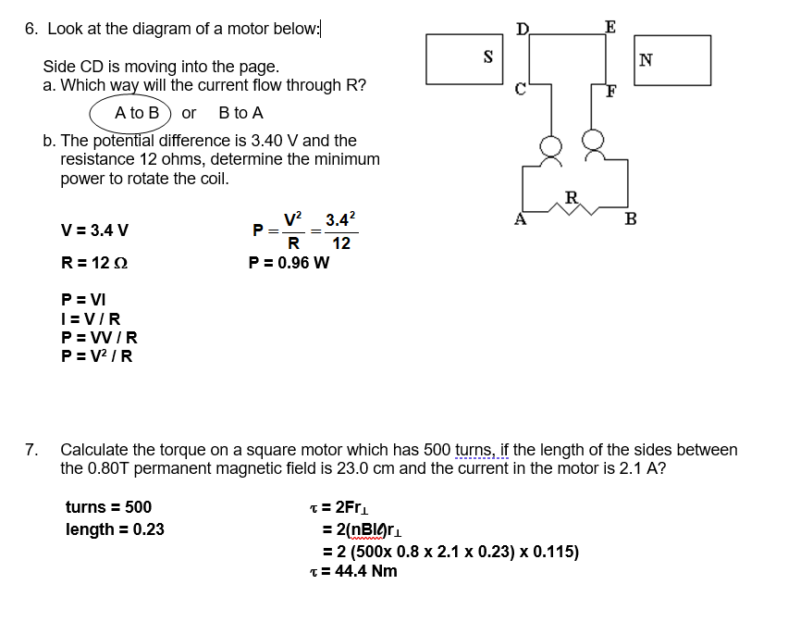
6. Look at the diagram of a motor below:
Side CD is moving into the page.
Which way will the current flow through R?
A to B or B to A
The potential difference is 3.40 V and the resistance 12 ohms, determine the minimum power to rotate the coil.
7a. Calculate the torque on a square motor which has 500 turns, if the length of the sides between the 0.80T permanent magnetic field is 23.0 cm and the current in the motor is 2.1 A?
7b
Using the same total length of wire as 7a, the design of the motor was changed to rectangular with a length of 46 cm and a width of 11.5 cm.
Assuming the same current and field strength, calculate the torque of the new design?

Slide 6
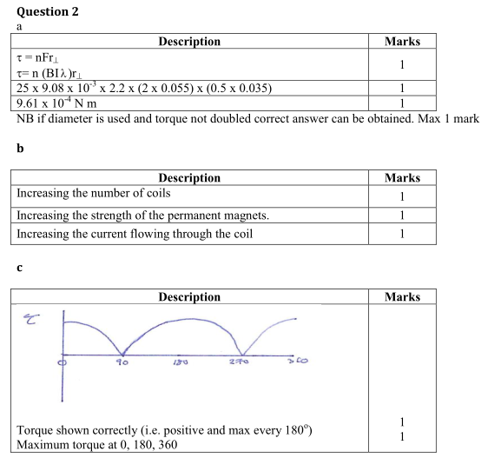

Slide 7
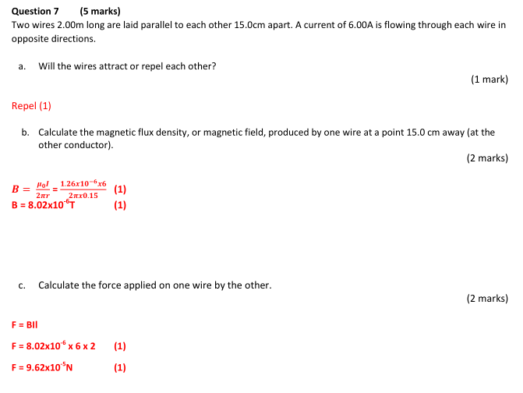
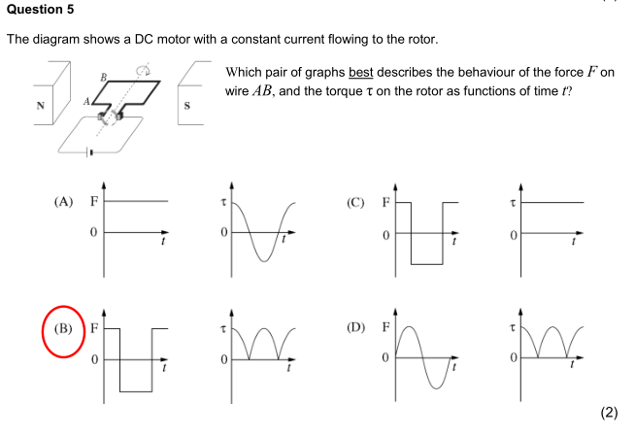

Slide 8
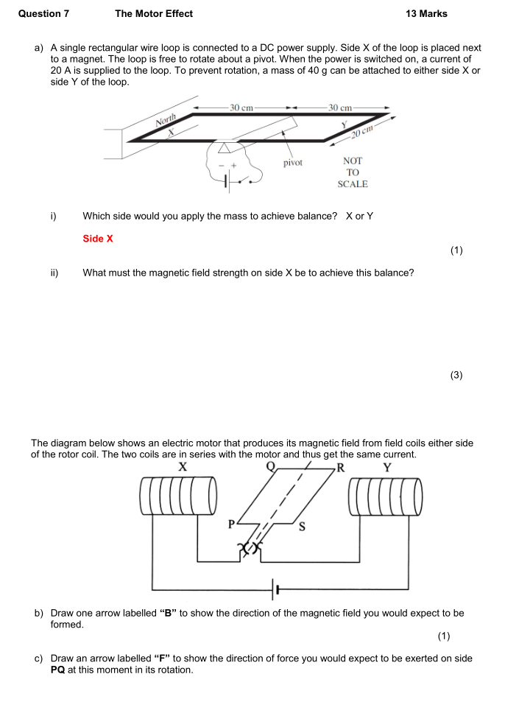
No answers

